Slide 1
CMP301 – Computer Networking Lecture week 5
Dr. Godwin Idoje
Email: Gidoje@qa.com

Slide 2
Transport and Application Layers
Goal:
understand principles behind transport layer services:
multiplexing, demultiplexing
reliable data transfer
fUDP: connectionless transport
TCP: connection-oriented reliable transport
Principles of network applications
Web and HTTP
E-mail, SMTP, IMAP
The Domain Name System DNS, DHCP
Material: gathered, edited and synthesized by Omar
Source:
CCNA: Introduction to Networks
&
Computer Networking: A Top-Down Approach

Slide 3
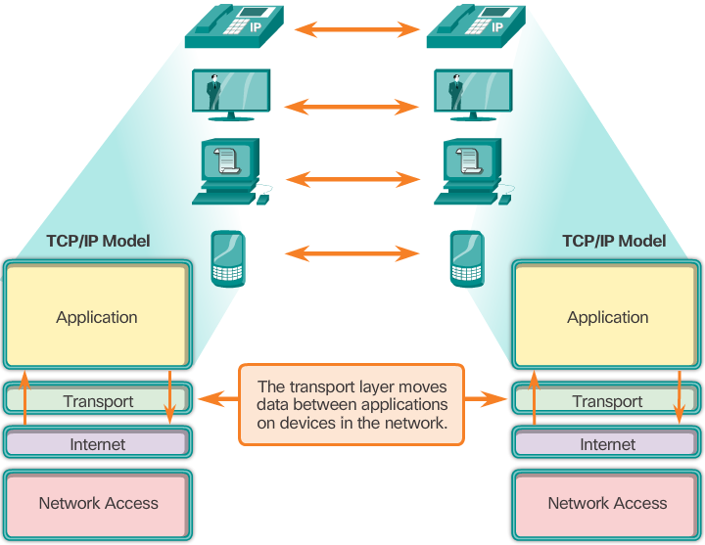
Role of the Transport Layer
The transport layer is responsible for establishing a communication session between two applications and delivering data between them.
The transport layer provides services, such as:
Connection-oriented support
Reliability
Flow control
Multiplexing

Slide 4









Transport services and protocols
application
transport
network
data link
physical
provide logical communication between application processes running on different hosts
mobile network
national or global ISP
transport protocols actions in end systems:
sender: breaks application messages into segments, passes to the network layer
Receiver: reassembles segments into messages, passes to the application layer
logical end-end transport
local or regional ISP
home network
content
provider
network
application
transport
network
data link
physical
datacenter
network
two transport protocols available to Internet applications
TCP, UDP
enterprise
network

Slide 5
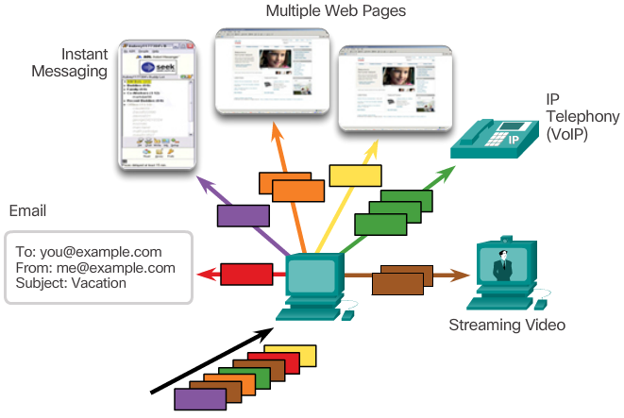
Transport Layer Responsibilities
Track Individual Conversations: By tracking each individual conversation flowing between a source application and a destination application separately.
Segment Data and Reassemble Segments: By dividing the data into segments that are easier to manage and transport.
Identify the Applications: By ensuring even when multiple applications are running on a device, all applications receive the correct data.

Slide 6
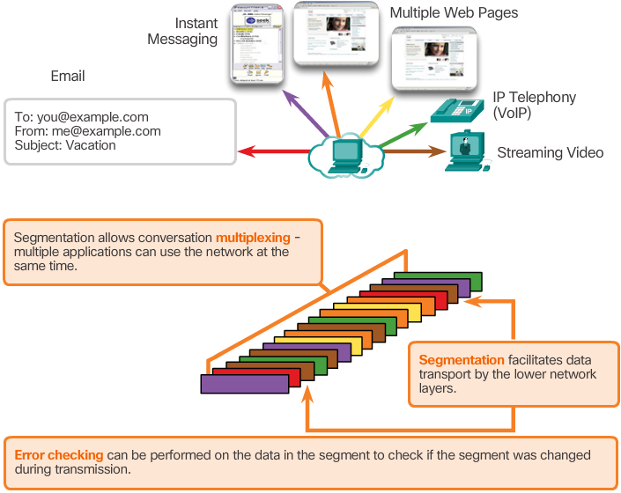
Conversation Multiplexing
Segmenting the data into smaller chunks enables many different communications, from many different users, to be interleaved (multiplexed) on the same network.
The transport layer adds a header that contains binary data to identify each segment of data and to enable various transport layer protocols to perform different functions in the management of data communication.

Slide 7
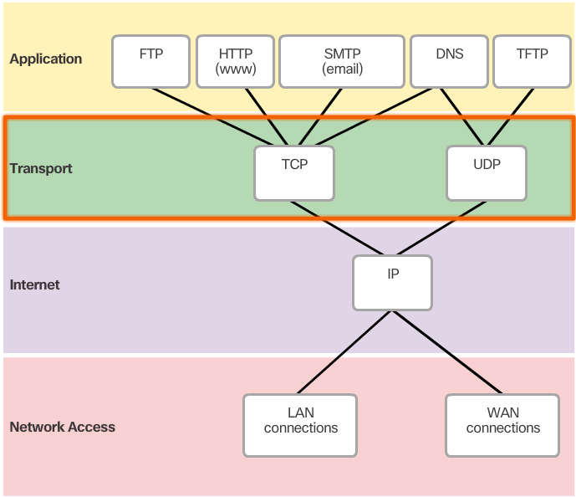
Transport Layer Reliability
The transport layer is also responsible for managing reliability.
Some applications may not require reliability. Transport layer requirements vary from application to application.
TCP/IP suite provides two transport layer protocols, Transmission Control Protocol (TCP) and User Datagram Protocol (UDP).
TCP is considered a reliable, full-featured transport layer protocol, which allows for packet data delivery confirmation.
In contrast, UDP is a very simple transport layer protocol that does not provide any reliability.

Slide 8
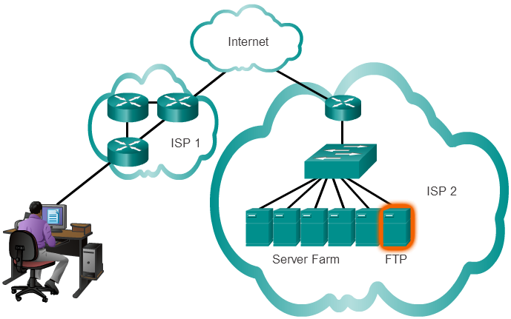
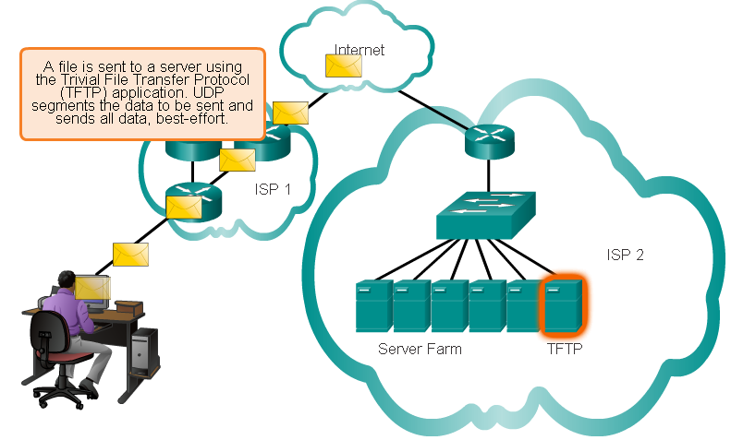
TCP
Vs.
UDP
TCP transport is reliable because it supports packet delivery confirmation.
There are three basic operations that enable reliability with TCP:
Numbering and tracking data segments transmitted to a specific host from a specific application
Acknowledging received data
Retransmitting any unacknowledged data after a certain period of time
If reliability is not required, UDP is a better transport protocol.
Some applications do not require reliability. Reliability incurs additional overhead and possible delays in transmission.
UDP provides the basic functions for delivering data segments between the appropriate applications, with very little overhead and data checking.

Slide 9
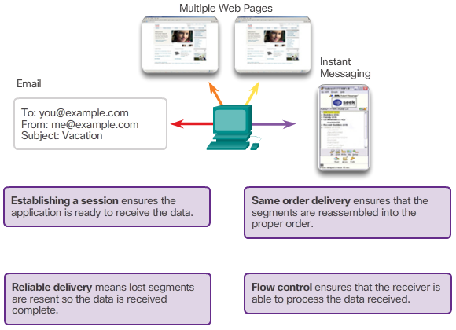
TCP Features

Slide 10
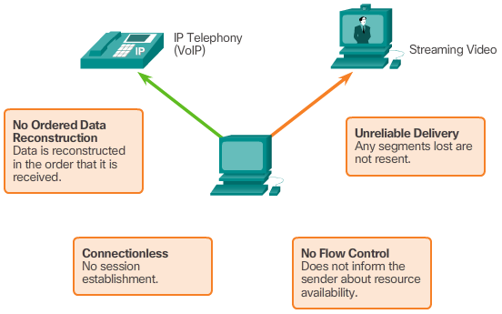
UDP Features

Slide 11
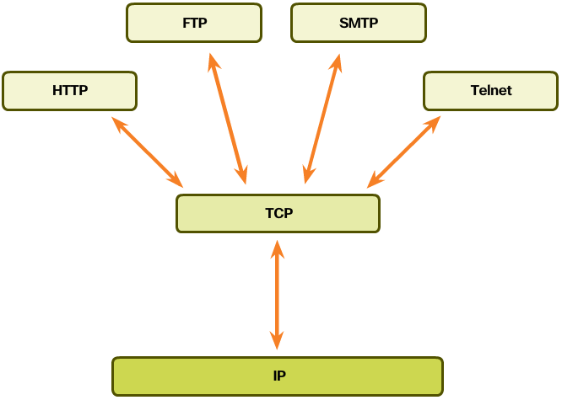
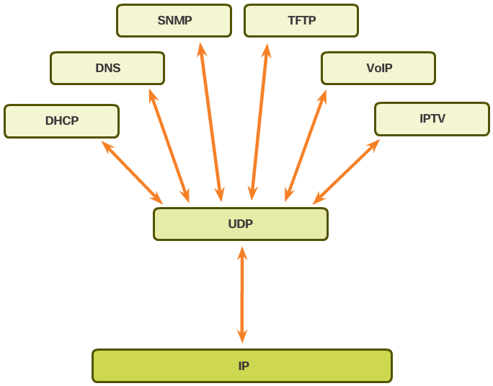
Transport Layer Protocols: which is more suitable?
TCP is a better choice for:
Applications whose segments must arrive in a very specific sequence to be processed successfully.
Application in which all data must be fully received before any is considered useful.
Applications requiring TCP include: Databases, Web browsers, Email clients.
UDP is a better choice for applications that can tolerate some data loss during transmission, but delays in transmission are unacceptable.
Applications using UDP include:
Live audio streaming
live video streaming
Voice over IP (VoIP)

Slide 12
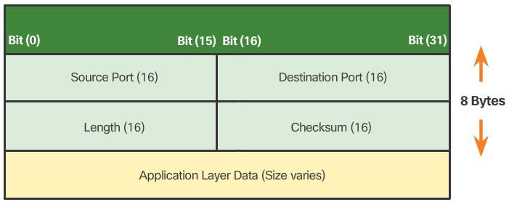
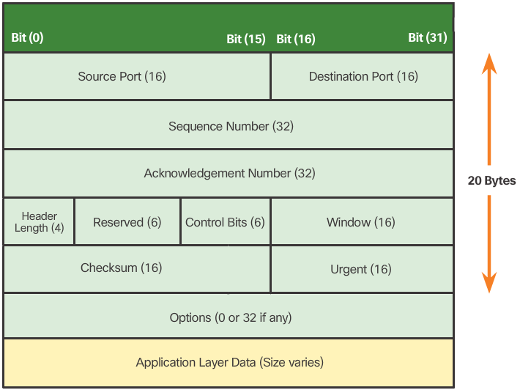
TCP Header
UDP Header
TCP is a stateful protocol. It keeps track of the state of the communication session.
Each TCP segment has 20 bytes of overhead in the header encapsulating the application layer data.
UDP is a stateless protocol.
If needed: reliability must be handled by the application.
UDP has a low overhead of 8 bytes.

Slide 13
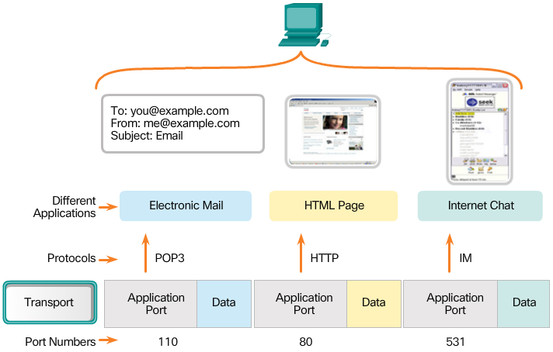
Port Numbers
Source Port
The source port number is dynamically chosen by the sending device to identify a conversation between two devices.
An HTTP client usually sends multiple HTTP requests to a web server at the same time. Each separate HTTP conversation is tracked based on the source ports.
Destination Port
Used to identify an application or service running in the server.
A server can offer more than one service at the same time, offering a web service on port 80 and FTP on port 21 simultaneously.

Slide 14
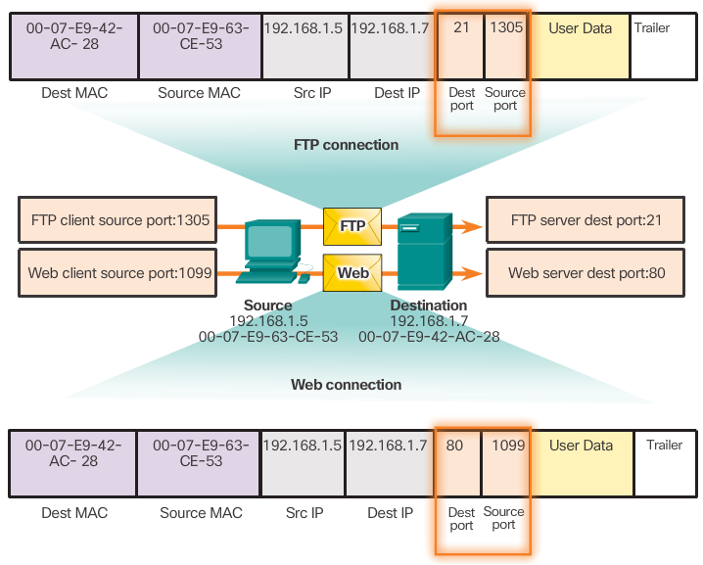
Socket Pairs
The combination of the source IP address and source port number, or the destination IP address and destination port number, is known as a socket.
The socket is used to identify the server and service being requested by the client.
Two sockets combine to form a socket pair: (192.168.1.5:1099, 192.168.1.7:80)
Sockets enable multiple processes running on a client and multiple connections to a server process to be distinguished from each other.
The source port number acts as a return address for the requesting application.
It is the transport layer’s job to keeps track of active sockets.

Slide 15


Multiplexing/demultiplexing
multiplexing at sender: handle data from multiple sockets, add transport header (later used for demultiplexing)
demultiplexing at receiver: use header info to deliver received segments to correct socket
host receives IP datagrams
each datagram has source IP address, destination IP address
each datagram carries one transport-layer segment
each segment has source, destination port number
host uses IP addresses & port numbers to direct segment to appropriate socket
application
application
P1
P2
application
socket
P3
transport
P4
process
transport
network
transport
network
link
network
link
physical
link
physical
physical

Slide 16
Connectionless demultiplexing
Recall: when creating datagram to send into UDP socket, must specify
destination IP address
destination port #
Connectionless demultiplexing: IP/UDP datagrams with same dest. port #, but different source IP addresses and/or source port numbers will be directed to same socket at receiving host
when receiving host receives UDP segment:
checks destination port # in segment
directs UDP segment to socket with that port #

Slide 17

Connectionless demultiplexing: an example
application
application
P1
application
P3
P4
transport
transport
network
transport
network
link
network
link
physical
link
physical
physical
source port: 6428
dest port: 9157
source port: ?
dest port: ?
source port: 9157
dest port: 6428
source port: ?
dest port: ?

Slide 18

Connection-oriented demultiplexing: example
server may support many simultaneous TCP sockets:
each socket identified by its
source IP address
source port number
dest IP address
dest port number
each socket associated with a different connecting client
application
application
P4
P5
P6
application
P1
P2
P3
transport
transport
network
transport
network
link
network
link
physical
link
Three segments, all destined to IP address B,
dest port: 80 are demultiplexed to different sockets
physical
server: IP address B
physical
host: IP address A
source IP,port: B,80
dest IP,port: A,9157
host: IP address C
source IP,port: C,5775
dest IP,port: B,80
source IP,port: A,9157
dest IP, port: B,80
source IP,port: C,9157
dest IP,port: B,80

Slide 19
Stop-and-wait operation
sender
receiver
first packet bit transmitted, t = 0
Round trip time RTT
L / R: time to generate packet bits and put them on the channel – depending on channel capacity R and packet length L
first packet bit arrives
RTT
last packet bit arrives, send ACK
ACK arrives, send next
packet, t = RTT + L / R
The sender will not send a new piece of data until it is sure that the receiver has correctly received the current packet.
Protocol limits performance of underlying infrastructure (channel) – efficiency loses when RTT is much more important than L/R
Improvement - pipelining: sender allows multiple, yet-to-be-acknowledged packets
Sequence numbers to be added to packets
buffering at sender and/or receiver

Slide 20
Pipelining: increased utilization
sender
receiver
first packet bit transmitted, t = 0
last bit transmitted, t = L / R
first packet bit arrives
RTT
last packet bit arrives, send ACK
last bit of 2nd packet arrives, send ACK
last bit of 3rd packet arrives, send ACK
ACK arrives, send next
packet, t = RTT + L / R
3-packet pipelining increases
utilization by a factor of 3!

Slide 21
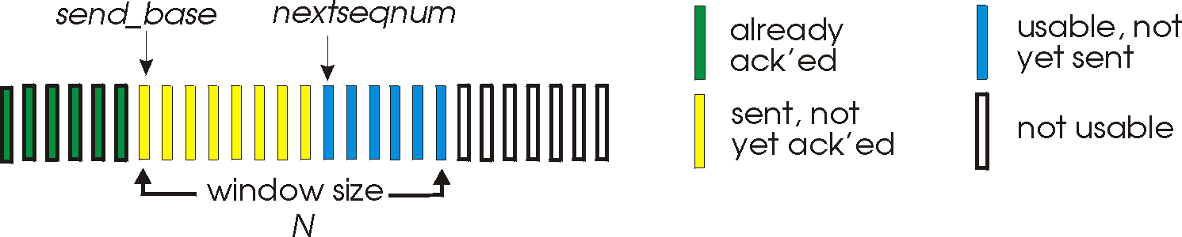
Go-Back-N
Sender : uses a “window” of up to N, consecutive transmitted but unacknowledged packets
cumulative ACK: ACK(n): ACKs all packets up to, including n
on receiving ACK(n): move window forward to begin at n+1
timer for oldest in-flight packet
timeout(n): retransmit packet n and all higher seq num. packets in window
Receiver: ACK-only: always send ACK for correctly-received packet so far, with highest in-order sequence num.
may generate duplicate ACKs
on receipt of out-of-order packet:
re-ACK pkt with highest in-order sequence num.

Slide 22

Go-Back-N in action
sender window (N=4)
sender
receiver
0 1 2 3 4 5 6 7 8
send pkt0
send pkt1
send pkt2
send pkt3
(wait)
0 1 2 3 4 5 6 7 8
receive pkt0, send ack0
receive pkt1, send ack1
receive pkt3, discard,
(re)send ack1
0 1 2 3 4 5 6 7 8
X
0 1 2 3 4 5 6 7 8
loss
0 1 2 3 4 5 6 7 8
rcv ack0, send pkt4
0 1 2 3 4 5 6 7 8
rcv ack1, send pkt5
receive pkt4, discard,
(re)send ack1
ignore duplicate ACK
receive pkt5, discard,
(re)send ack1
pkt 2 timeout
0 1 2 3 4 5 6 7 8
send pkt2
send pkt3
send pkt4
send pkt5
0 1 2 3 4 5 6 7 8
rcv pkt2, deliver, send ack2
rcv pkt3, deliver, send ack3
rcv pkt4, deliver, send ack4
rcv pkt5, deliver, send ack5
0 1 2 3 4 5 6 7 8
0 1 2 3 4 5 6 7 8

Slide 23
Selective repeat
receiver individually acknowledges all correctly received packets
buffers packets, as needed, for eventual in-order delivery to upper layer
sender times-out/retransmits individually for unACKed packets
sender maintains timer for each unACKed packet
sender window
N consecutive sequence numbers

Slide 24
Selective Repeat in action
sender window (N=4)
sender
receiver
0 1 2 3 4 5 6 7 8
send pkt0
send pkt1
send pkt2
send pkt3
(wait)
0 1 2 3 4 5 6 7 8
receive pkt0, send ack0
receive pkt1, send ack1
receive pkt3, buffer,
send ack3
0 1 2 3 4 5 6 7 8
X
0 1 2 3 4 5 6 7 8
loss
0 1 2 3 4 5 6 7 8
rcv ack0, send pkt4
0 1 2 3 4 5 6 7 8
rcv ack1, send pkt5
receive pkt4, buffer,
send ack4
record ack3 arrived
receive pkt5, buffer,
send ack5
pkt 2 timeout
0 1 2 3 4 5 6 7 8
send pkt2
(but not 3,4,5)
0 1 2 3 4 5 6 7 8
0 1 2 3 4 5 6 7 8
rcv pkt2; deliver pkt2,
pkt3, pkt4, pkt5; send ack2
0 1 2 3 4 5 6 7 8
Q: what happens when ack2 arrives?

Slide 25
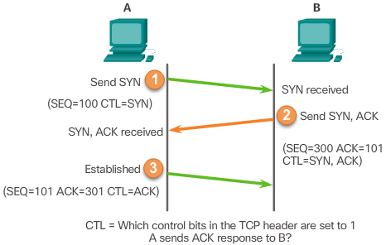
TCP Connection Establishment
A TCP connection is established in three steps:
The initiating client requests a client-to-server communication session with the server.
The server acknowledges the client-to-server communication session and requests a server-to-client communication session.
The initiating client acknowledges the server-to-client communication session.

Slide 26
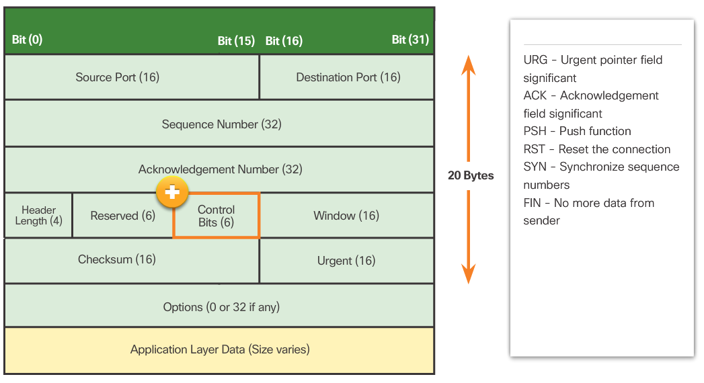
TCP Three-Way Handshake Analysis
The three-way handshake:
Establishes that the destination device is present on the network.
Verifies that the destination device has an active service and is accepting requests on the destination port number that the initiating client intends to use
Informs the destination device that the source client intends to establish a communication session on that port number.

Slide 27
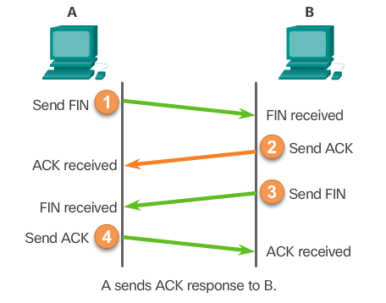
TCP Session Termination
The FIN TCP flag is used to terminate a TCP connection.
When the client has no more data to send in the stream, it sends a segment with the FIN flag set.
The server sends an ACK to acknowledge the receipt of the FIN to terminate the session from client to server.
The server sends a FIN to the client to terminate the server-to-client session.
The client responds with an ACK to acknowledge the FIN from the server.
When all segments have been acknowledged, the session is closed.
Notes:
FIN means finish flag for TCP connection

Slide 28
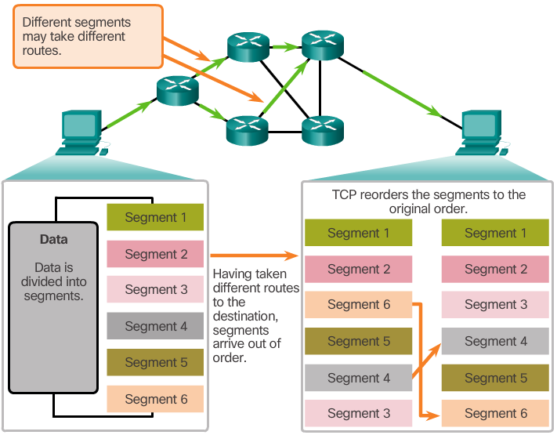
TCP Reliability – Ordered Delivery
TCP segments use sequence numbers to uniquely identify and acknowledge each segment, keep track of segment order, and indicate how to reassemble and reorder received segments.
An initial sequence number (ISN) is randomly chosen during the TCP session setup. The ISN is then incremented by the number of transmitted bytes.
The receiving TCP process buffers the segment data until all data is received and reassembled.
Segments received out of order are held for later processing.
The data is delivered to the application layer only when it has been completely received and reassembled.

Slide 29
TCP Reliability - Sequence Numbers and Acknowledgements
TCP is designed to confirm that each segment reached its destination.
TCP session setup ensures the destination is not only reachable, but ready to receive data.
The TCP process on the destination host acknowledges the data it has received from the source application.
TCP allows for the retransmission of missed segments.
TCP ensures all segments are properly re-ordered upon receipt.
TCP session termination allows for parties to gracefully end a TCP session when no data is to be transferred (FIN flag).
A TCP endpoint can abruptly terminate a session if necessary (RST flag).
Notes:
RST flag stands for reset of the transmission

Slide 30
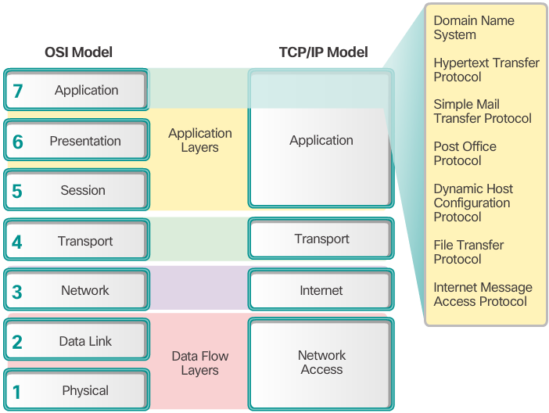
Application Layer
The application layer is closest to the end user.
Network applications enable users to send and receive data with ease.
The application layer acts as interface between the applications and the underlying network.
Application layer protocols help exchange data between programs running on the source and destination hosts.
The TCP/IP application layer performs the functions of the upper three layers of the OSI model.
Common application layer protocols include: HTTP, FTP, TFTP, DNS.

Slide 31
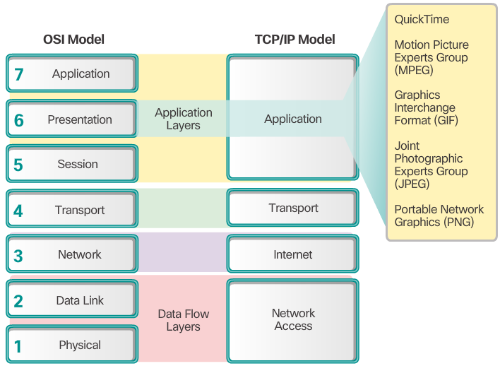
Presentation and Session Layer
The presentation layer has three primary functions:
Format data
Compress data
Encrypt data
Common standards for video include QuickTime and Motion Picture Experts Group (MPEG).
Common graphic image formats are:
Graphics Interchange Format (GIF)
Joint Photographic Experts Group (JPEG)
Portable Network Graphics (PNG) format

Slide 32
Presentation and Session Layer (cont.)
The session layer creates and maintains dialogs between source and destination applications.
The session layer handles the exchange of information to initiate dialogs, keep them active, and to restart sessions that are disrupted or idle for a long period of time.

Slide 33
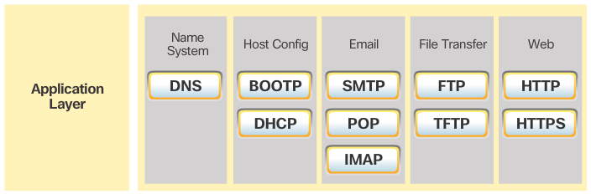
TCP/IP Application Layer Protocols
TCP/IP application protocols specify the format and control information necessary for common Internet functions.
Application layer protocols must be implemented in both the source and destination devices.
Application layer protocols implemented on the source and destination host must be compatible to allow communication.

Slide 34
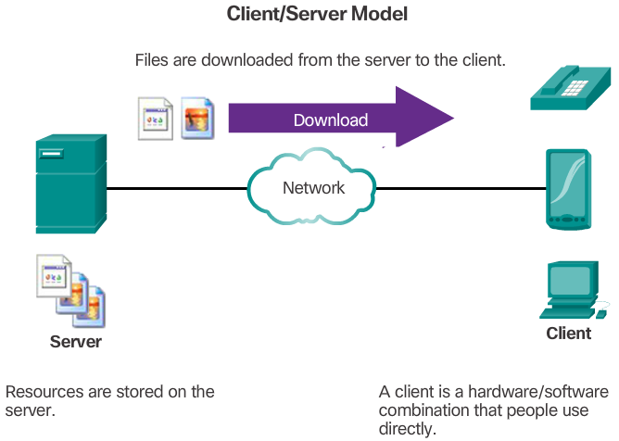
Client-Server Model
The device requesting the information is called a client.
The device responding to the request is called a server.
Client and server processes are considered to be in the application layer.
The client initiates the exchange by requesting data from the server.
The server responds by sending one or more streams of data to the client.
Application layer protocols describe the format of the requests and responses between clients and servers.
The contents of the data exchange will depend on the application in use.
Email is an example of a Client-Server interaction.

Slide 35
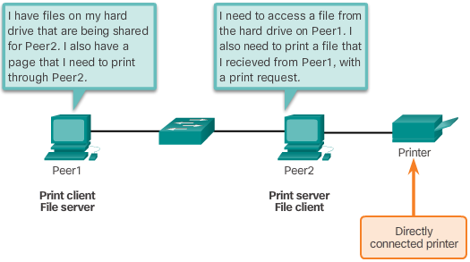
Peer-to-Peer Networks
In the peer-to-peer (P2P) networking model, the data is accessed without the use of a dedicated server.
Two or more computers can be connected to a P2P network to share resources.
Every connected end device (a peer) can function as both a server and a client.
The roles of client and server are set on a per request basis.

Slide 36
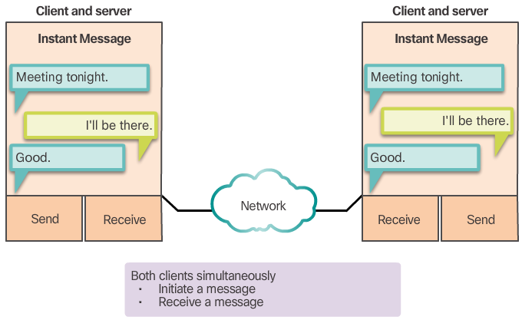
Peer-to-Peer Applications
Some P2P applications use a hybrid system.
In hybrid P2P, resource sharing is decentralized.
Indexes that point to resource locations are stored in a centralized directory.
In a hybrid system, each peer accesses an index server to get the location of a resource stored on another peer.

Slide 37
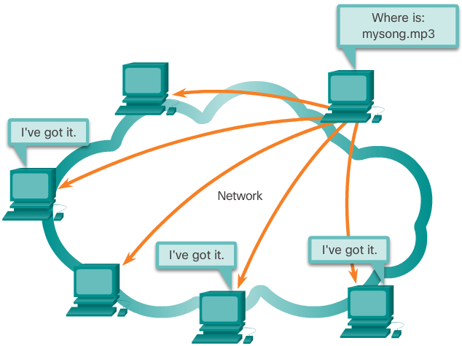
Common P2P Applications
Common P2P networks include: eDonkey, G2, BitTorrent, Bitcoin.
Many P2P applications allow users to share pieces of many files with each other at the same time.
A small torrent file contains information about the location of other users and tracker computers.
Trackers are computers keeping track of the files hosted by users.
This technology is called BitTorrent.
There are many BitTorrent clients, including BitTorrent, uTorrent, Frostwire, and qBittorrent.

Slide 38
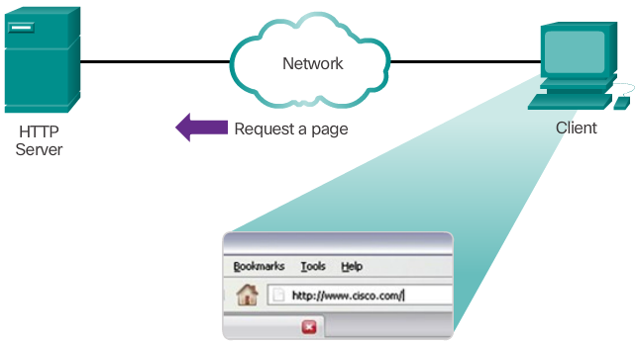
Hypertext Transfer Protocol and Hypertext Markup Language
A web address or uniform resource locator (URL) is a reference to a web server.
URLs and Uniform Resource Identifier (URIs) are the names most people associate with web addresses.
A URL allows a web browser to establish a connection to that web server: it has three basic parts:
http (the protocol or scheme)
www.cisco.com (the server name)
index.html (the specific filename requested)
Using DNS, the server name portion of the URL is then translated to the associated IP address before the server can be contacted.
HTTP Protocol Step 1

Slide 39
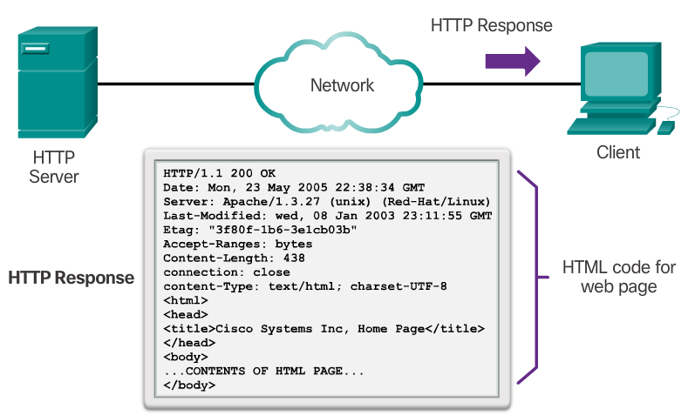
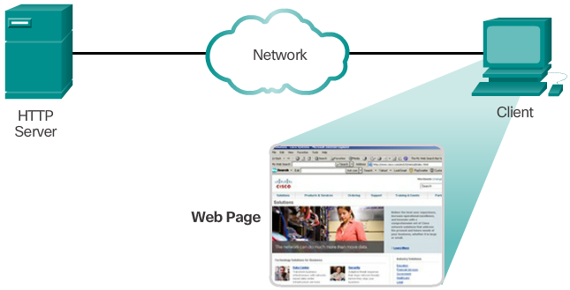
Hypertext Transfer Protocol and Hypertext Markup Language
The browser sends a GET request to the server’s IP address and asks for the index.html file.
The server sends the requested file to the client. The index.html was specified in the URL and contains the HTML code for this web page.
The browser processes the HTML code and formats the page for the browser window based on the code in the file.
HTTP
Is a request/response protocol.
Has three common message types: GET, POST, PUT.
Is not secure. Messages can be intercepted.
HTTP Protocol Step 2
HTTP Protocol Step 3

Slide 40
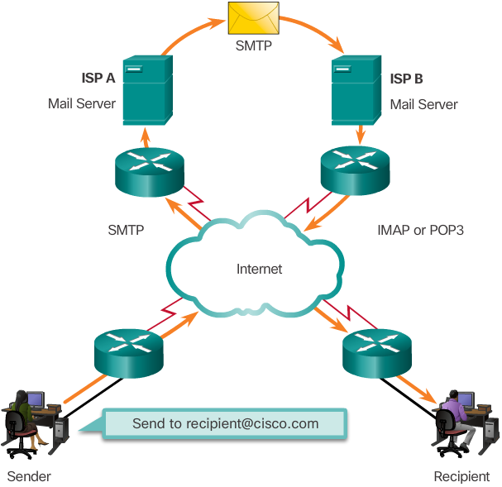
Email Protocols
Email is a store-and-forward method of sending, storing, and retrieving electronic messages.
Email clients do not communicate directly when sending email: Email relies on three separate protocols for operation: SMTP (sending),POP (retrieving), IMAP (retrieving).
Email messages are stored in databases on mail servers.
Email clients communicate with mail servers to send and receive email.
Mail servers communicate with other mail servers to transport messages from one domain to another.

Slide 41
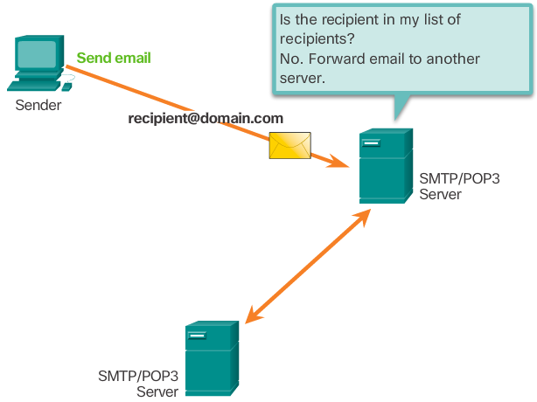
SMTP Operation
An SMTP client sends an email by connecting to a SMTP server on port 25.
The server receives the message and stores it message in a local mailbox or relays the message to another mail server.
Users use email clients to retrieve messages stored on the server.
IMAP and POP are two protocols commonly used by email clients to retrieve messages.

Slide 42
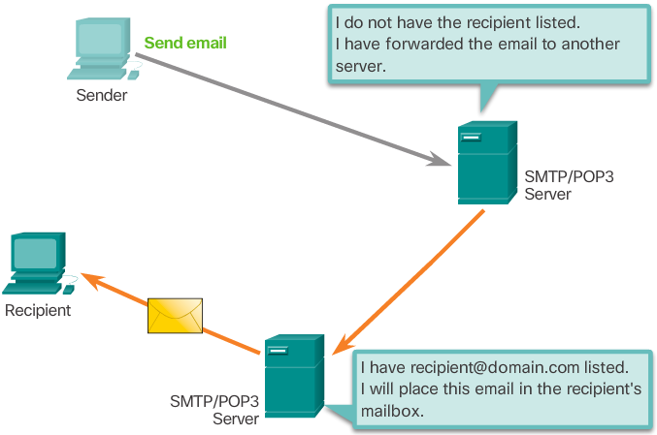
POP Operation
Messages are downloaded from the server to the client.
The server listens on port 110 TCP for client requests.
Email clients direct their POP requests to mail servers on port TCP 110.
The POP client and server exchange commands and responses until the connection is closed or aborted.
POP allows for email messages to be downloaded to the client’s device (computer or phone) and removed from the server.
There is no centralized location where email messages are kept.
A downloaded message resides on the device that triggered the download.

Slide 43
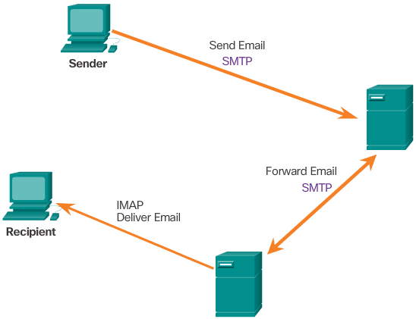
IMAP Operation
IMAP is another protocol used to retrieve email messages.
Allows for messages to be displayed to the user rather than downloaded.
The original messages reside on the server until manually deleted by the user.
Users view copies of the messages in their email client software.
Users can create a folder hierarchy on the server to organize and store mail.
That file structure is displayed on the email client.
When a user decides to delete a message, the server synchronizes that action and deletes the message from the server.

Slide 44
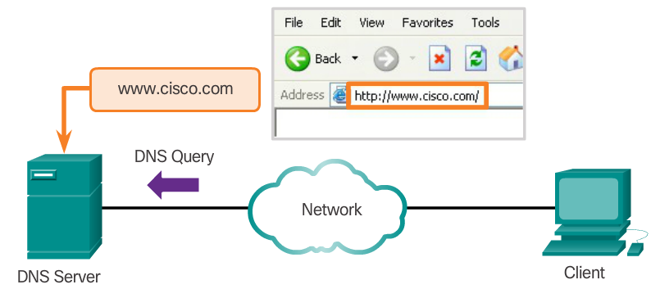
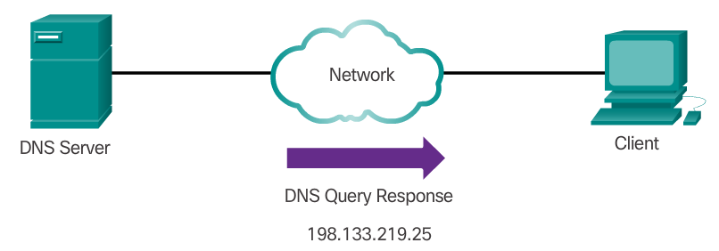
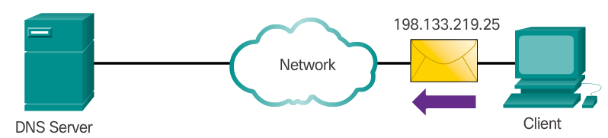
Domain Name Service
While IP addresses are crucial for network communication, they are not easy to memorize.
Domain names are created to make server addresses more user-friendly.
However, computers still need the actual numeric address before they can communicate.
The DNS protocol allows for the dynamic translation of a domain name into the correct IP address.
The DNS protocol communications using a single format called a message.

Slide 45
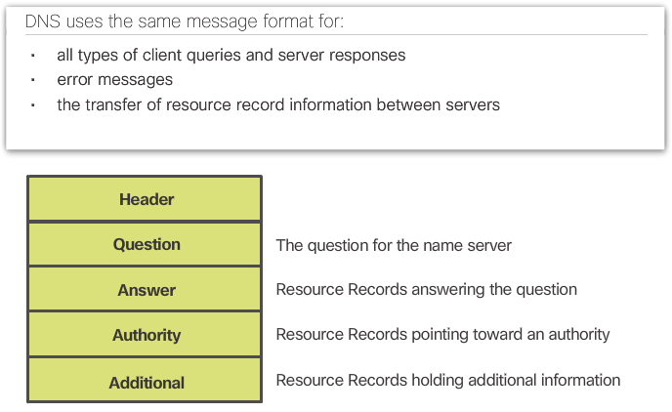
DNS Message Format
DNS supports different types of records. Some of these record types are:
A - An end device IPv4 address
NS - An authoritative name server
MX - A mail exchange record
DNS servers will first look at its own records to resolve the name. If the server is unable to resolve the name using its locally stored records, it relays the query to other servers.
The response is then forwarded to the requesting client.
The DNS Client service on Windows PCs also
stores previously resolved names in memory.
ipconfig /displaydns displays all of the cached
DNS entries on Windows.

Slide 46
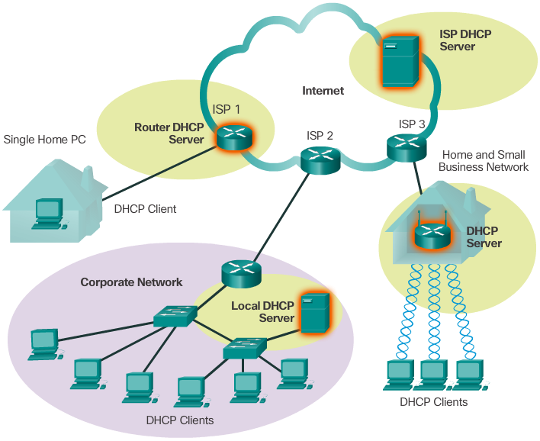
Dynamic Host Configuration Protocol
Computers need network addresses to communicate over a network.
Additional crucial information includes gateway address, subnet mask, and DNS server.
Manually configuring end devices is not scalable. DHCP allows for automated distribution of network information.
DHCP-distributed addresses are leased for a set period of time.
Addresses are returned to the pool of addresses for reuse when no longer in use.
DHCP supports IPv4 and DHCPv6 supports IPv6.

Slide 47
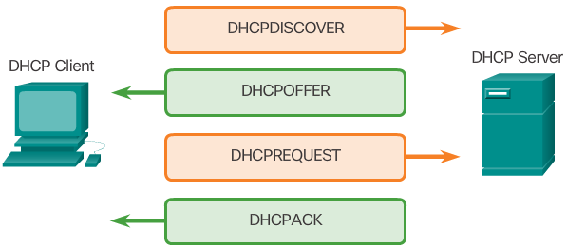
DHCP Operation
A DHCP client goes through the following basic steps to request an IP:
The client broadcasts a DHCPDISCOVER.
A DHCP server replies with a DHCPOFFER message
The client sends a DHCPREQUEST message to the server it wants to use (in case of multiple offers).
A client may also choose to request an address that it had previously been allocated by the server.
The server returns a DHCPACK message to confirm the lease has been finalized.
The server would respond with a DHCPNAK if the offer is no longer valid
Leases must be renewed before its expiration through another DHCPREQUEST.

Slide 48
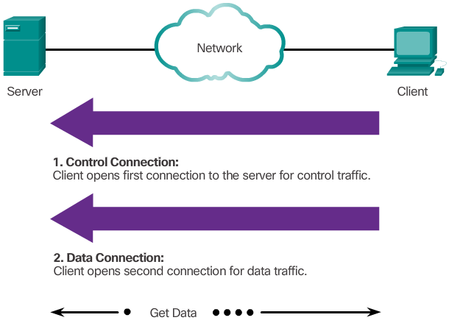
File Transfer Protocol
FTP was developed to allow the transfer of files over the network.
An FTP client is an application that runs on a client computer used to push and pull data from an FTP server.
FTP requires two connections between the client and the server: one connection for commands and replies and another connection for the actual file transfer.
The client initiates and establishes the first connection to the server for control traffic on TCP port 21.
The client then establishes the second connection to the server for the actual data transfer on TCP port 20.
The client can download (pull) data from the server or upload (push) data to the server.

